Slide 1
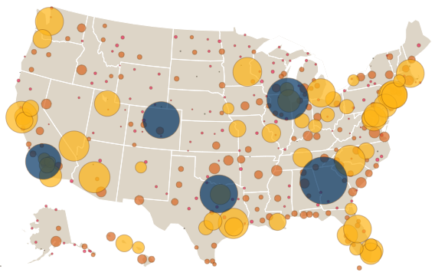
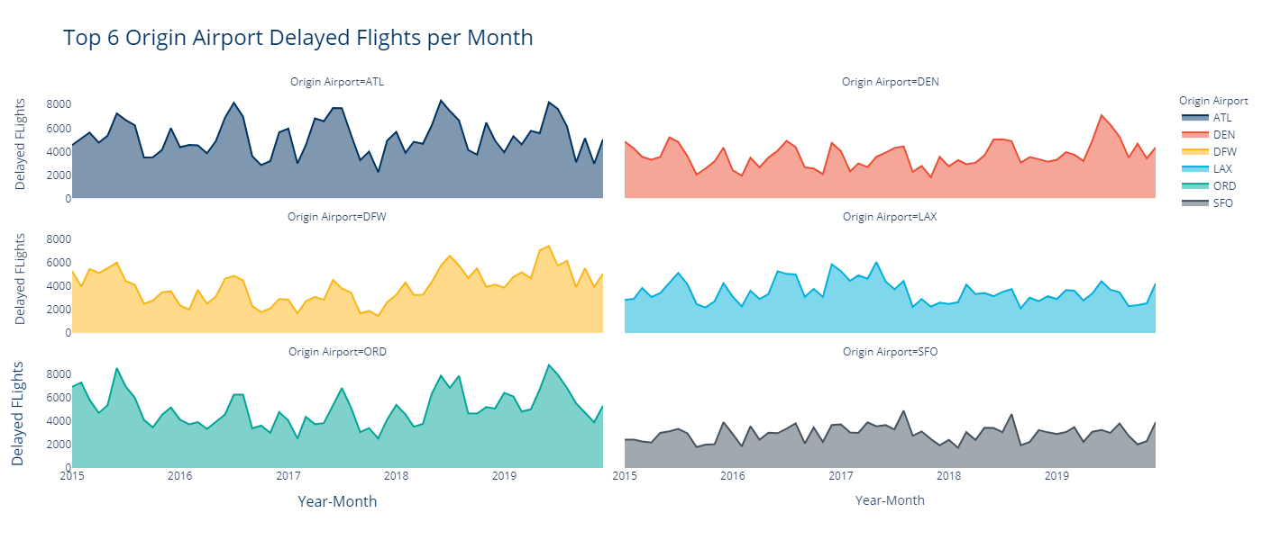
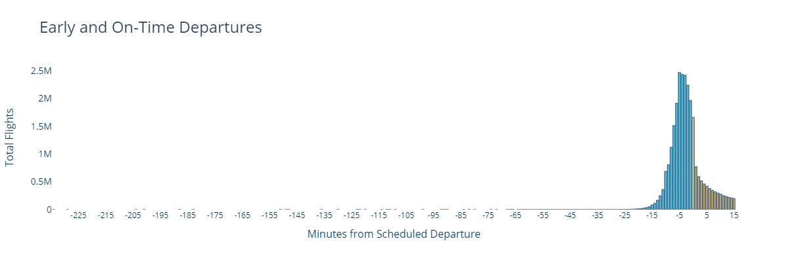
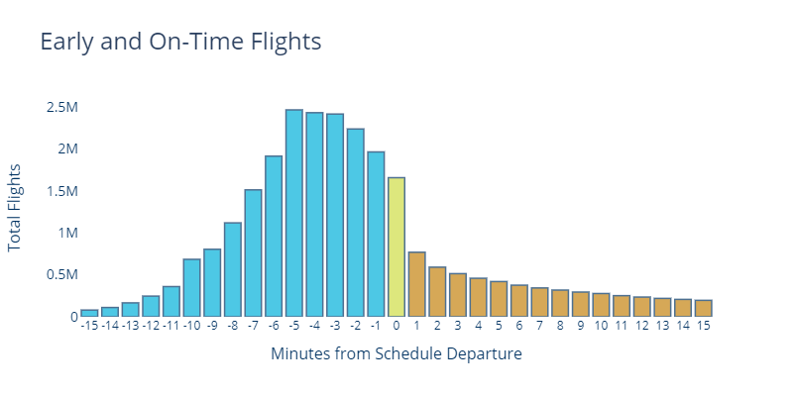
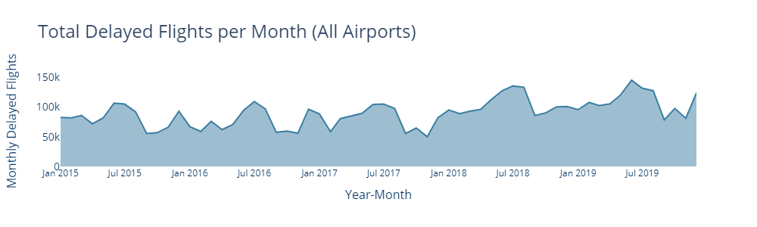
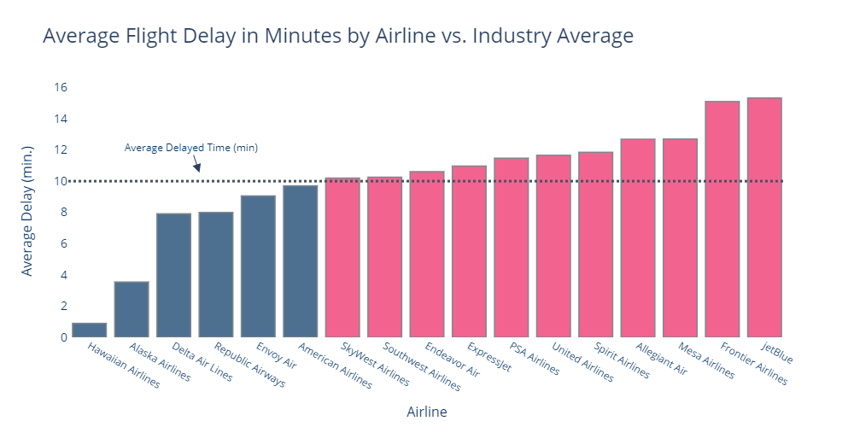
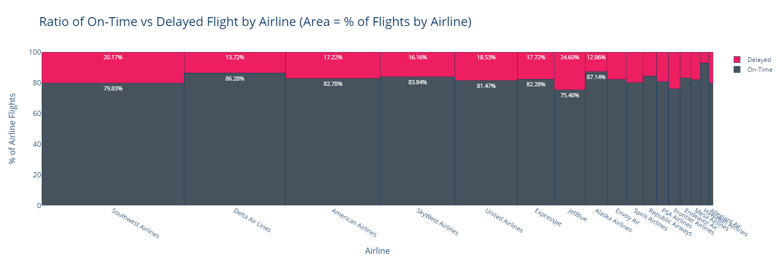
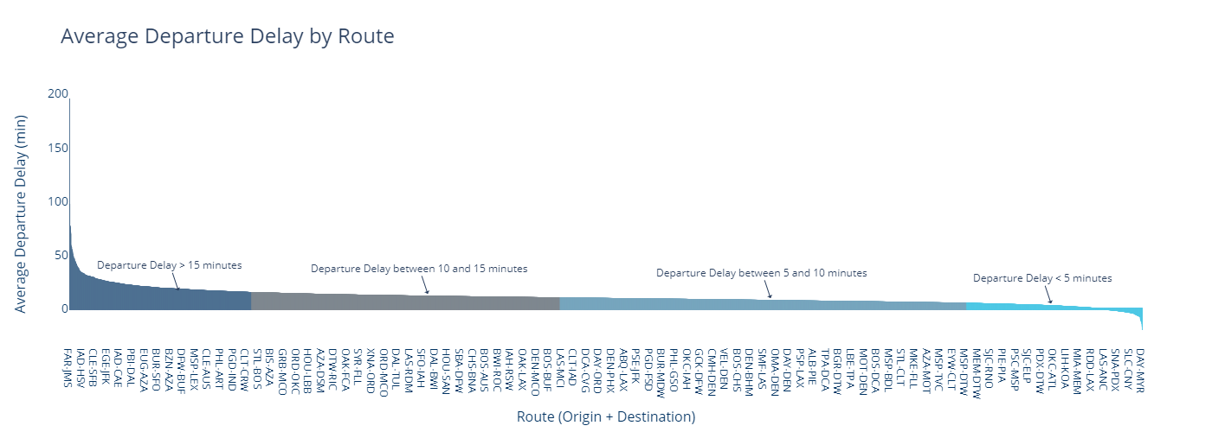
W261
Final Presentation
FLIGHTS
Delayed & Ontime Prediction

Slide 2
W261
Final Presentation
PROJECT INTRODUCTION (NOT SHOWN IN PRESENTATION MODE)

Slide 3
W261
Final Presentation
Delayed & Ontime Flights Prediction project overview
Ning (Louis) Li
Andrew Fogarty
Siduo (Stone) Jiang
Cristopher Benge
louisli@ischool.berkeley.edu
afogarty@ischool.berkeley.edu
siduojiang@ischool.berkeley.edu
crisbenge@ischool.berkeley.edu
The FAA estimated an annual cost of $28B in 2018 for direct and indirect losses due exclusively to flight delays. In addition to the factors included in this number (direct loss, decreased demand, and lost passenger time), airlines must also manage extra gates, more ground personnel, delay shippers, and impact their brand. Worse, these costs are increasing YOY with the only noteworthy decrease being in raw fuel expense [1].
This project aims to provide a simple solution for improving consumer response and discovery of the underlying causes of delays in flights through prediction of flight delays two hours prior to scheduled flight departure.
Project GitHub

Slide 4
W261
Final Presentation
Delayed & Ontime Flights Prediction project lifecycle
04 – Model Experimentation
02 – Naïve Model
Various model architectures are evaluated, compared to baseline, and minor tuning is performed to identify the most suitable strategy.
A naïve model is created to serve as a baseline and to validate that all the plumbing work done from ingest to inference.
01 - EDA
Exploratory data analysis is performed to understand the data and the challenges we’ll have to address to achieve acceptable data processing times and model performance.
03 – Cleaning & Augmentation
05 – Tuning
Cleaning and augmentation of the training data set is a significant part of any ML project; this one was no exception.
Hyperparameter tuning, regularization, and other optional techniques (such as generalized stacking) are performed to fine-tune for ideal performance.

Slide 5







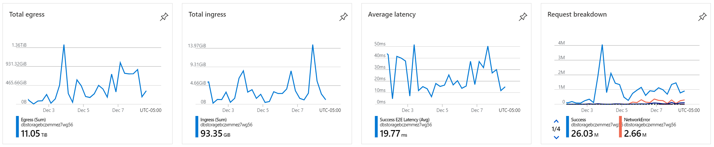
W261
Final Presentation
Delayed & Ontime Flights Prediction Solution Component Architecture
Source Data
Azure Compute Components
Cluster Composition
Cluster BOM
8 x Standard_D8_v3
32GiB RAM
8 vCPU (E5-2673 v3 Haswell)
200GiB SSD
NIC x 4 (high bw)
1 x Standard_F64_v2
128GiB RAM
64 vCPU (Skylake)
512GiB SSD
NIC x 8 (extreme high bw)
Table
CSV
Azure Databricks
Azure Blob Storage
Parquet
Clusters x 3
Data
Processing Platform
Compute

Slide 6
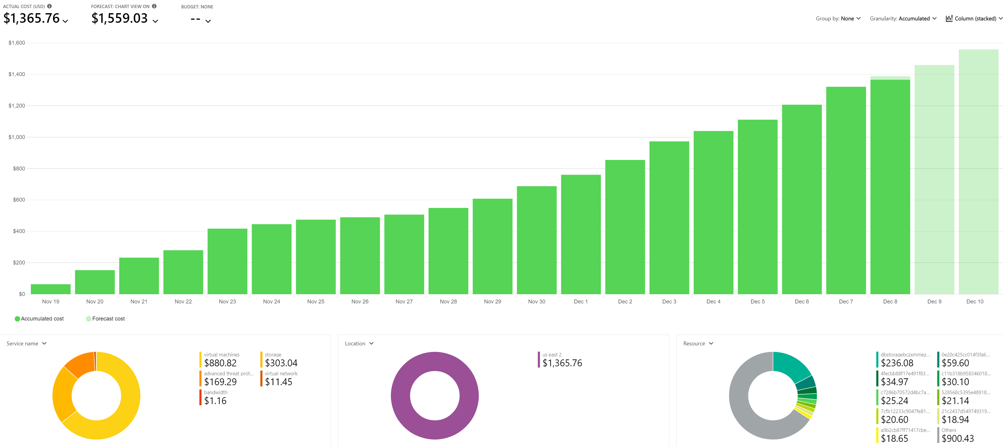
Delayed & Ontime Flights Prediction Solution Budget

Slide 7
W261
Final Presentation
DATASET INTRODUCTION (NOT SHOWN IN PRESENTATION MODE)

Slide 8
W261
Final Presentation
Delayed & Ontime Flights Prediction source data introduction
Source: Airlines
Source: Weather
Source: Stations
U.S. domestic flight data for N airlines from 2015-2019.
Meteorological information from weather stations.
U.S.A.F. master weather station information data.
Our source data contained a mix of parquet and compressed CSV file formats, consisting of data from 2015 through 2019. Some other sub-sentence goes here to make a splash.

Slide 9
W261
Final Presentation
EDA SECTION (NOT SHOWN IN PRESENTATION MODE)

Slide 10
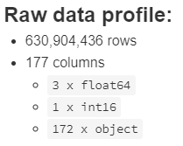
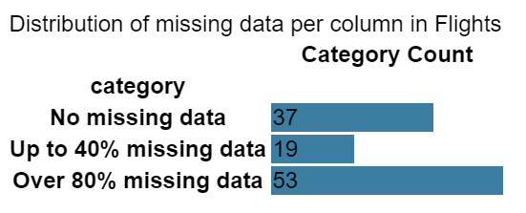
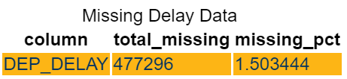
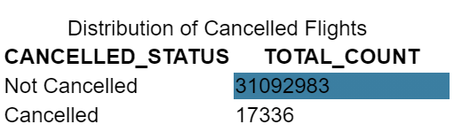
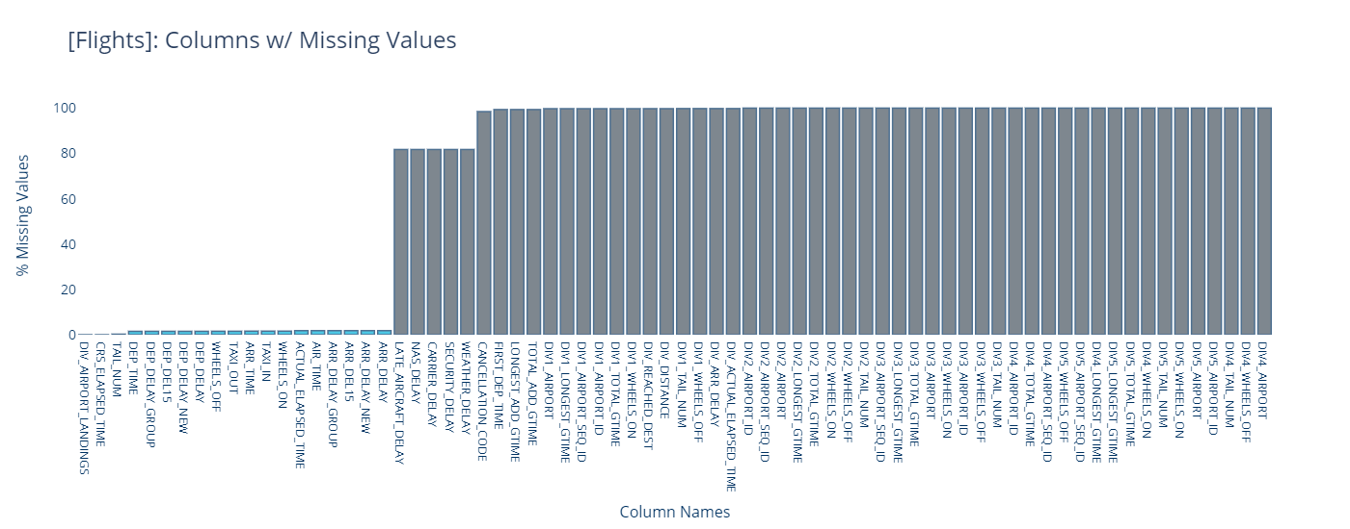
Final Presentation
W261
Airlines missing a lot of data; most columns are unusable. Some dependent variable values missing (~1.5%). Cancelled flights not likely to aid in prediction of pure delay.
SOURCE DATA:
AIRLINES (Profile)
Airlines Data

Slide 11
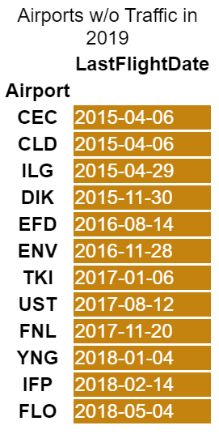
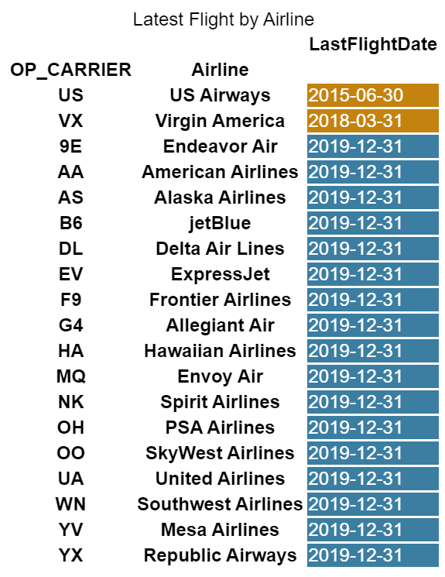
Final Presentation
W261
SOURCE DATA:
AIRLINES (Profile Contd.)
A number of airports have not had traffic in several years. US Airways is out of business, and Virgin America was integrated into Alaska Airlines in 2018.
Airlines Data

Slide 12
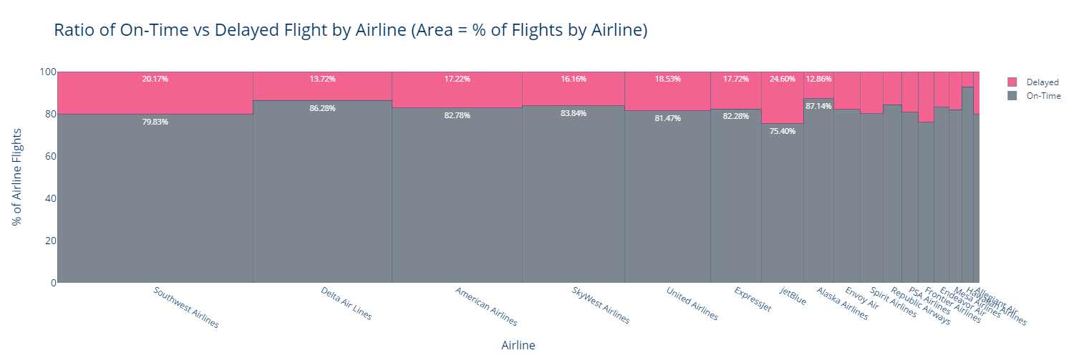
Final Presentation
W261
SOURCE DATA:
AIRLINES (Carriers)
Only 5 airlines with an average flight delay under the industry average of ~10 min. Southwest, Delta, and American Airlines are top 3 airlines represented in dataset. JetBlue has the worst on-time record at nearly ~25% of all flights being delays at or more than 15 minutes.
Airlines Data

Slide 13
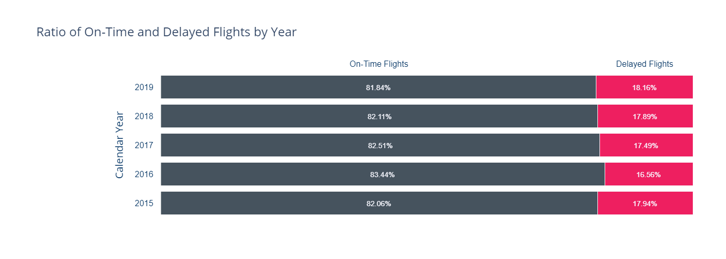
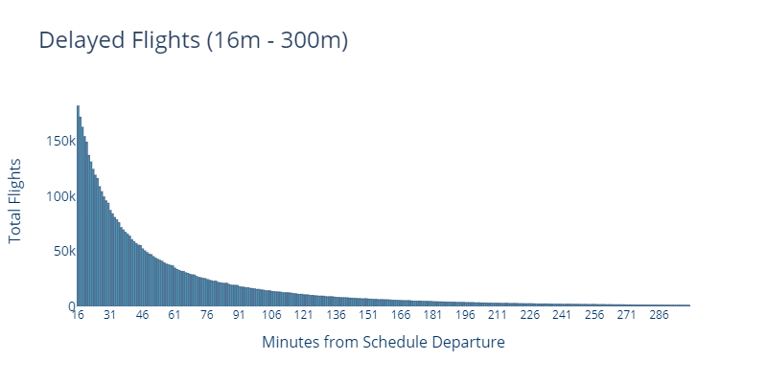
Final Presentation
W261
Early flight departures are problematic for airlines and airports; FAA recommends 5 min. early departure, and most airlines will not exceed 15 min. due to impact to schedule at receiving airport. We trim at 15 minutes early.
SOURCE DATA:
AIRLINES (Delays)
Airlines Data
Delayed departures (in minutes) follow an exponential distribution pattern with a long right-tail that maxes out at a delay value of ~45.92 hours.

Slide 14
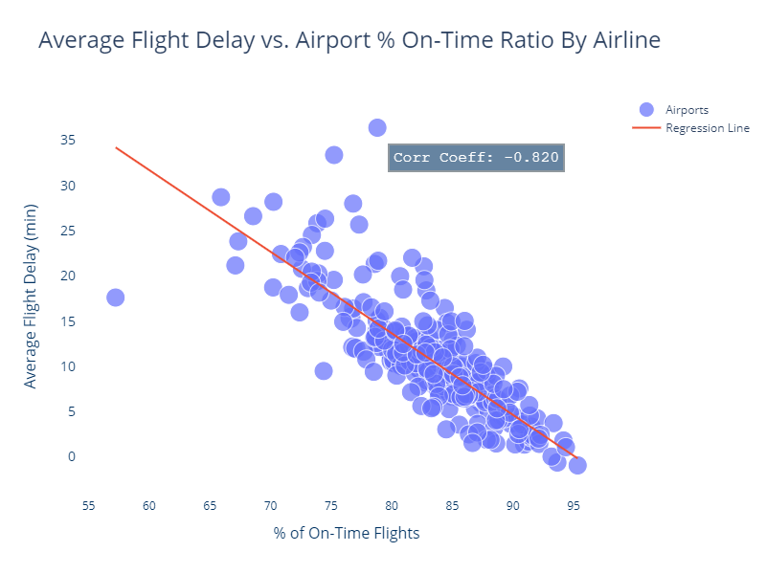
Final Presentation
W261
Temporal trends in delays does not reveal any notable pattern; however, airports that tend to have a greater percentage of on-time flights tend to have shorter delays.
SOURCE DATA:
AIRLINES (Delays Contd.)
Airlines Data

Slide 15
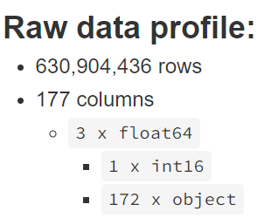
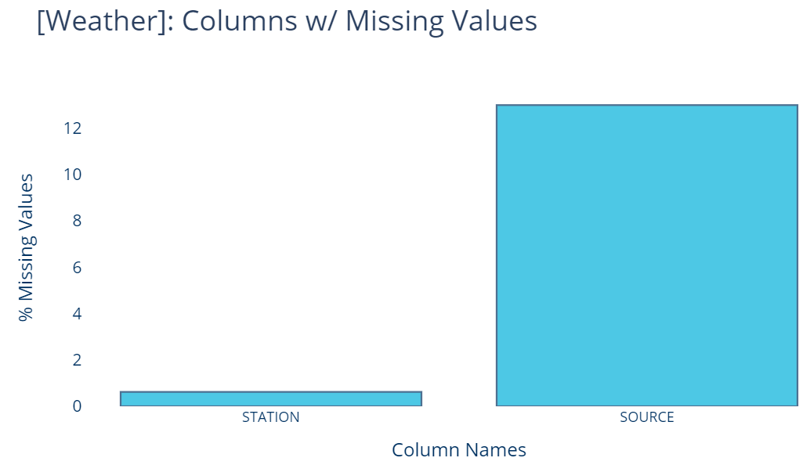
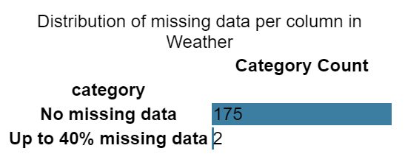
Final Presentation
W261
SOURCE DATA:
WEATHER (Profile)
Weather Data
At 630M records, this dataset was by far the largest to process. Though missing data analysis reported very few problematic columns and records, this is due to looking for NaN values only. Much of the data has empty string values, too.

Slide 16
Final Presentation
W261
SOURCE DATA:
WEATHER (Profile Contd.)
The [Weather] dataset contained only a few columns with no (or very low amounts of) missing data; these are depicted above. These were the only usable values imported and processed.
Weather Data

Slide 17
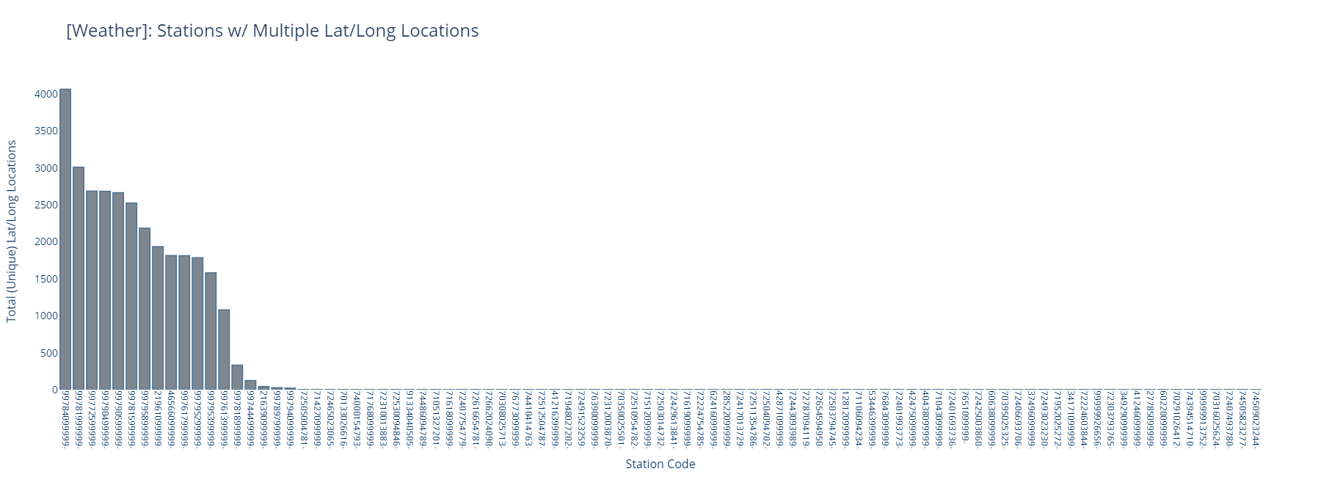
Final Presentation
W261
SOURCE DATA:
WEATHER (Profile Contd.)
Station code data is problematic; 91 station codes have 2 or more lat/long unique locations… ostensibly, some having thousands of different physical locations!
Weather Data

Slide 18
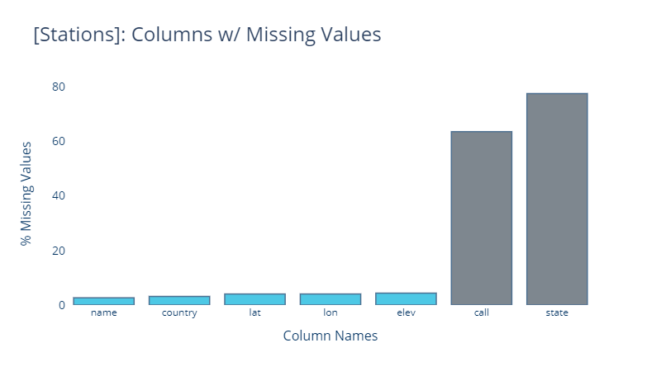
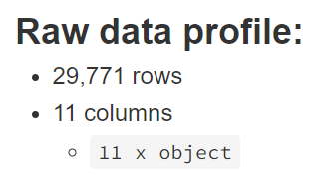
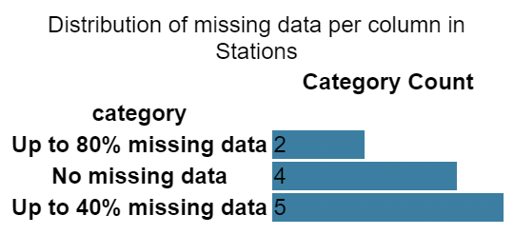
W261
Final Presentation
SOURCE DATA: STATIONS (Profile)

Slide 19
W261
Final Presentation
DATA ENGINEERING (NOT SHOWN IN PRESENTATION MODE)

Slide 20
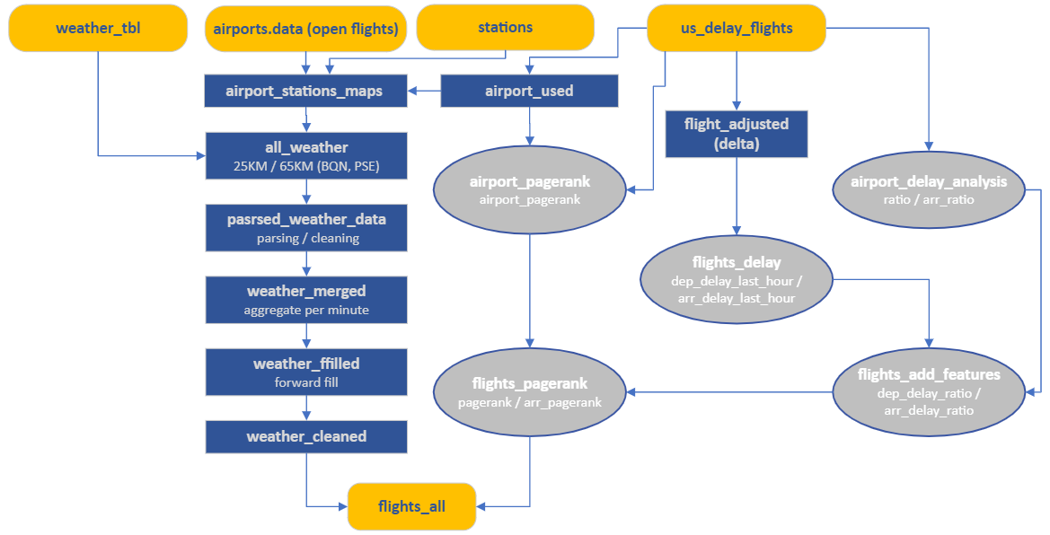

Slide 21
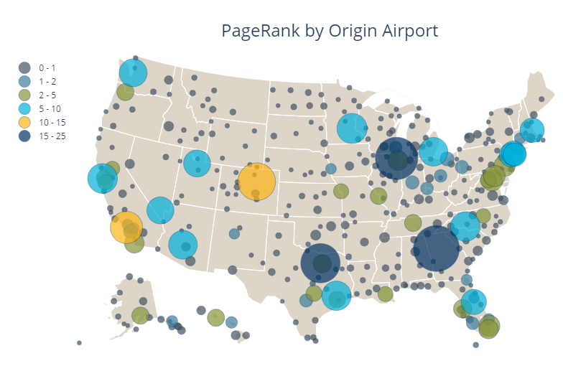
Final Presentation
W261
PageRank
Use PageRank algorithm to rank all US airports based on flight dataset
Features

Slide 22
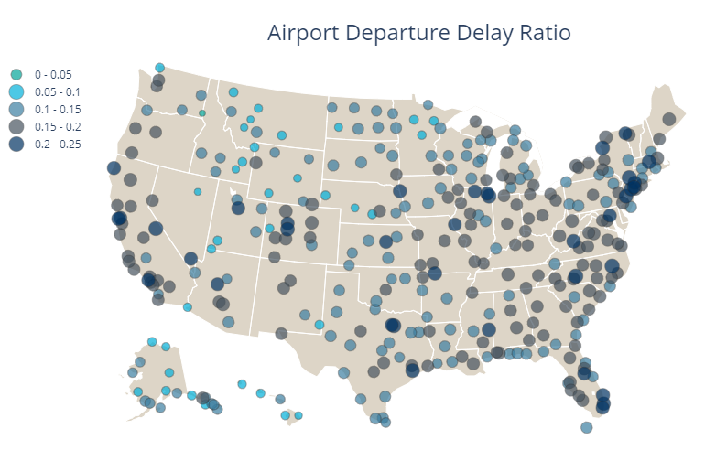
Final Presentation
W261
Airport Delay Ratio / Airport Delay Ratio Last Hour
Average delayed flights vs total flights for each airport.
Delayed flight in last hour vs average delay ratio
Features

Slide 23
Final Presentation
W261
Routes (Origin + Destination)
Presents the average departure delay in minutes for each origin + destination pair.
Features

Slide 24
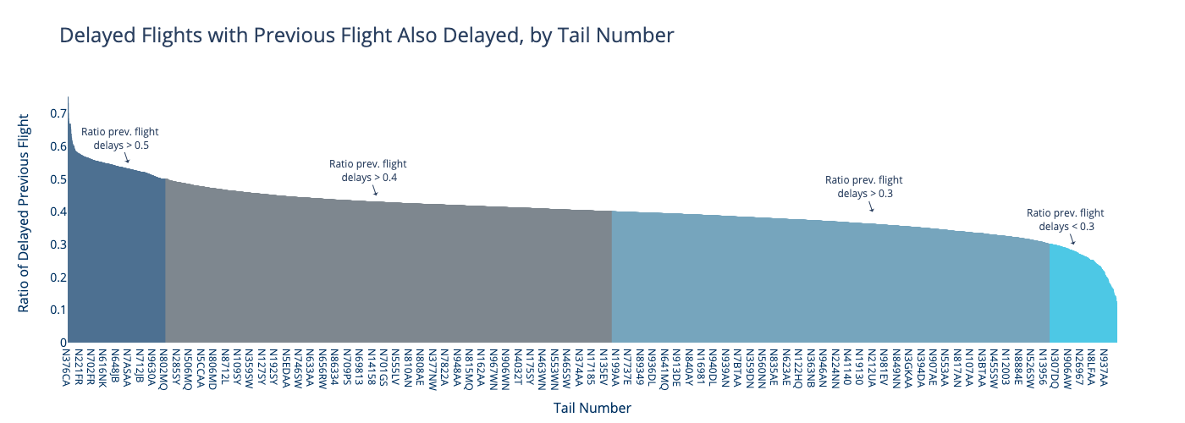
Final Presentation
W261
Previous flight delay
Presents whether or not the previous flight on the same plane is delayed
Features

Slide 25
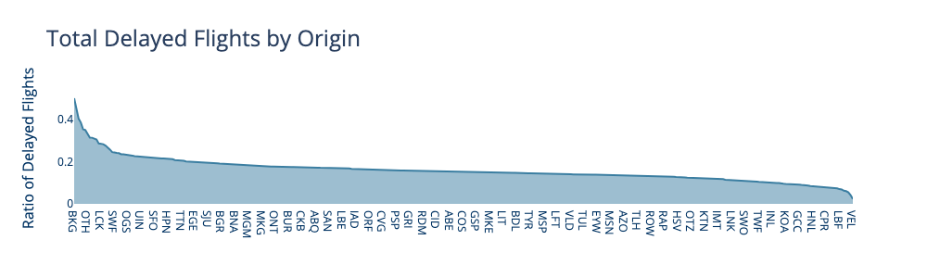
Final Presentation
W261
Bucketing on mean response
For categorical variables with too many categories, determine the fraction delayed of training data, and bin accordingly.
Features

Slide 26
W261
Final Presentation
METRICS (NOT SHOWN IN PRESENTATION MODE)

Slide 27
W261
Final Presentation
Delayed & Ontime Flights Prediction metrics evaluated
Data set is highly unbalanced, with ~80% of flight labeled as ”Not Delayed”
NOT Selected
Accuracy
Frequently used standard for binary classification. No need for a threshold – calculates over all thresholds
Selected
ROC AUC
Balances precision and recall. Deals with class imbalance.
Selected
F1 score

Slide 28
W261
Final Presentation
ALGORITHMS (NOT SHOWN IN PRESENTATION MODE)

Slide 29
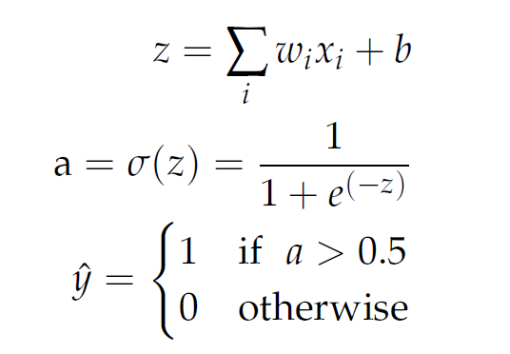
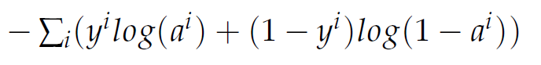
W261
Final Presentation
Delayed & Ontime Flights Prediction Algorithm Implementation: Logistic Regression
Linear Transformation:
Activation:
Predicted Y:
Cost Function:

Slide 30
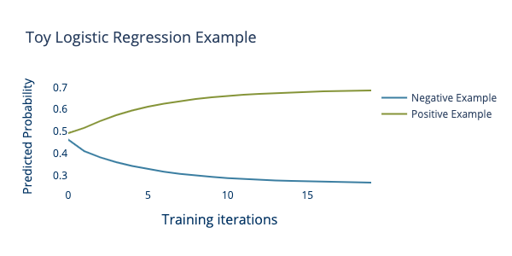
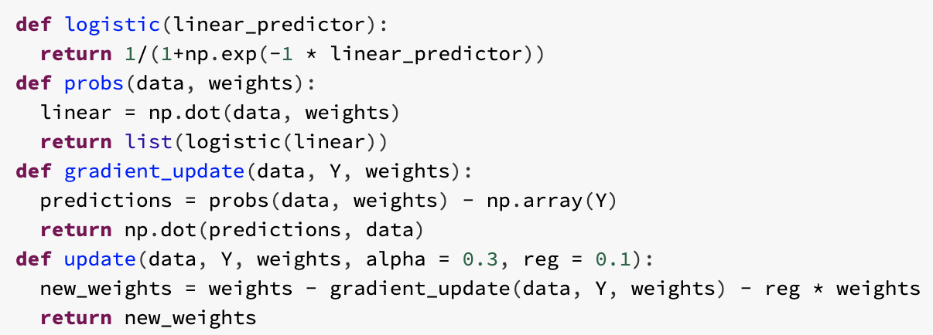
W261
Final Presentation
Delayed & Ontime Flights Prediction Algorithm Implementation: Logistic Regression
Single worker implementation with regularization
Training 20 iterations
Inference
Training
Also implemented reproducible toy example in Torch

Slide 31
W261
Final Presentation
Delayed & Ontime Flights Prediction algorithms

Slide 32
W261
Final Presentation
Delayed & Ontime Flights Prediction algorithms
Best models with 6 features
Logistic Regression
Random Forest
0.71 AUC
0.73 AUC
0.410 F1
0.434 F1
~20min training time
~20min training time
Threshold can be fine-tuned, improving F1 score to 0.440
Beats RF of 36 features
Yet another point

Slide 33




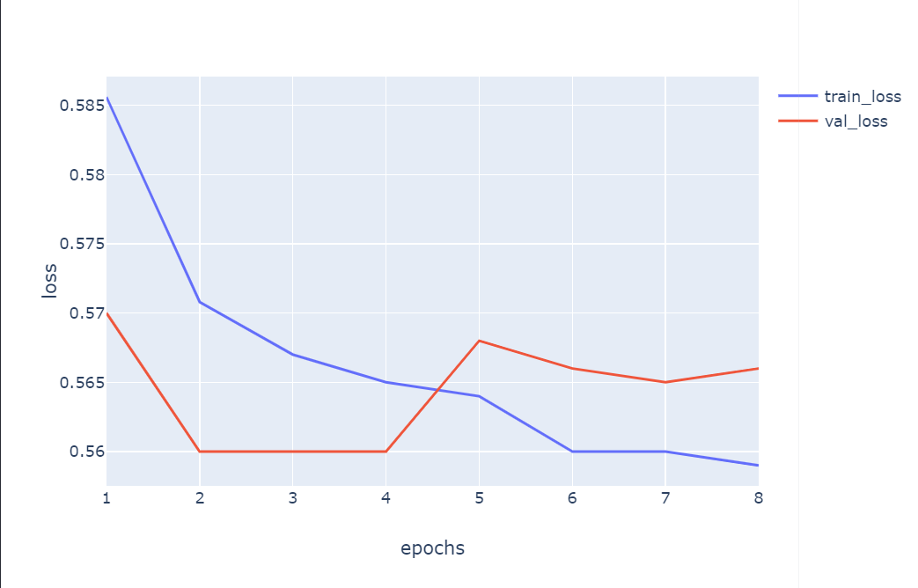
W261
Final Presentation
1
Top Performer #1
Neural Network
1
Highlights
Pipeline processed 102k rows/minute, on average, on CPU with 8 workers
Test Loss: 0.57, Test F1: 0.77
Pipeline
Architecture
Two Hidden Layers # [1000, 500] Neurons
Transforms categorical data into continuous embeddings on the fly
Concatenates and feeds embeddings and continuous features into forward()
Controls for time with a polynomial since last event
Model Highlights

Slide 34
W261
Final Presentation
PERFORMANCE & SCALE (NOT SHOWN IN PRESENTATION MODE)

Slide 35
Final Presentation
W261
SCALABILITY & PERFORMANCE
Highlights
Increasing partitions beyond number of workers appeared to have no effect on training speed
31 million row data set presents sharp contrasts between speed, cost, and model performance
Hyperparameter searches present theoretical and substantive challenges as to how generate them efficiently and effectively
Parquet files ideal for tabular data; file of choice for state-of-the-art Petastorm; allows the retrieval of only necessary columns
Model TIME
Logistic Regression
10 min
Random Forest
20 min
GBT
240 min
Neural Network
300 min
A quick comment to drive the point home goes here!
Measuring something?
72%

Slide 36
W261
Final Presentation
CHALLENGES & FUTURE (NOT SHOWN IN PRESENTATION MODE)

Slide 37
Trendy
Fresh & Clean
Delayed & Ontime Flights Prediction Challenges & Future Work
Challenges Future Work
1. Mistakes are costly
1. “Deploying” the model
2. “Simple” evaluation metrics
2. Delay conditions at destination
3. Embedding matrix for categorical data
3. Optimizing parquet file size and partitions
4. Using Petastorm

Slide 38
W261
Final Presentation
COURSE CONCEPTS (NOT SHOWN IN PRESENTATION MODE)

Slide 39
Application of Course Concepts
1. Parallelization, Partitioning, and Coalescing
2. Regularization
3. One-Hot Encoding
4. RDDs

Slide 40
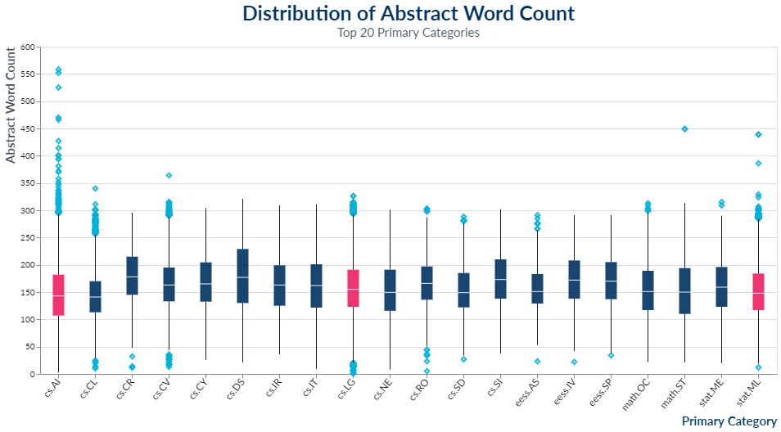
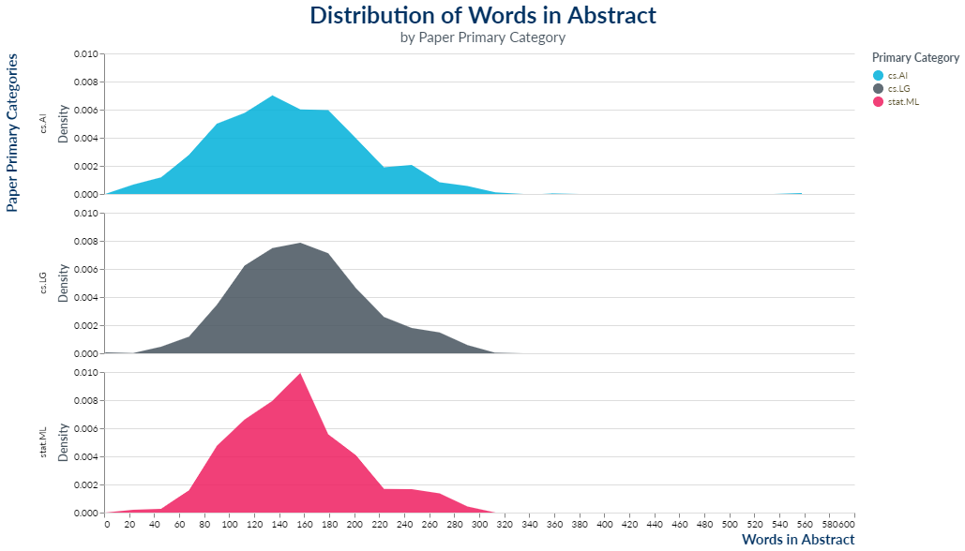
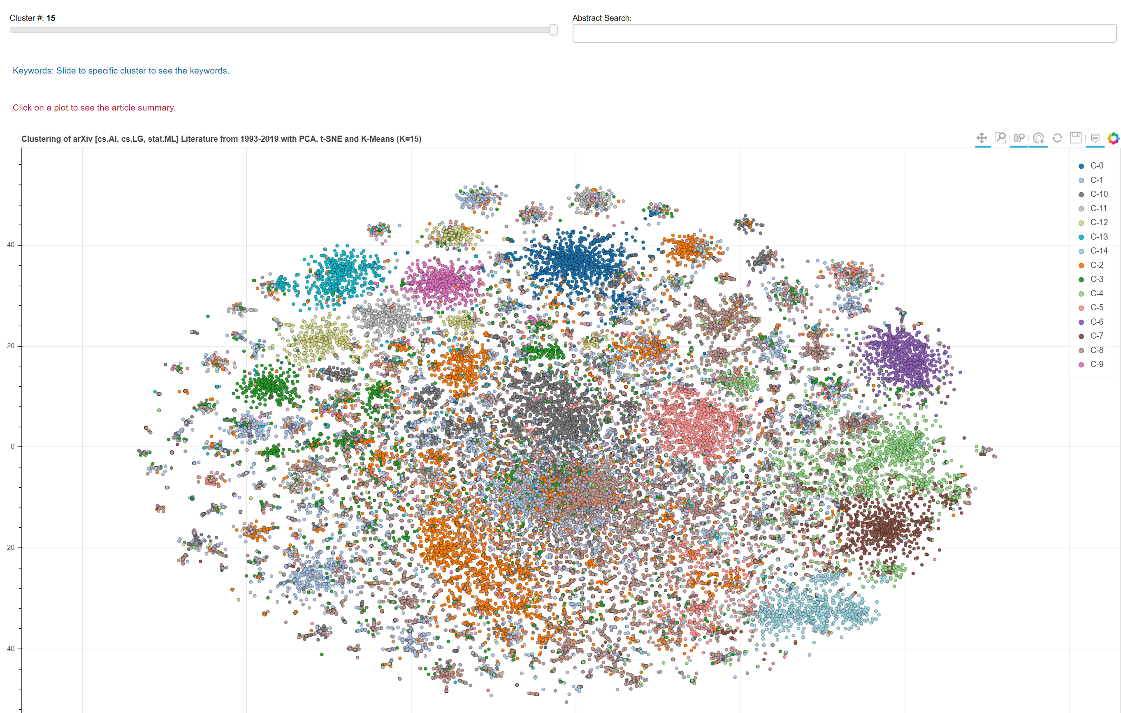
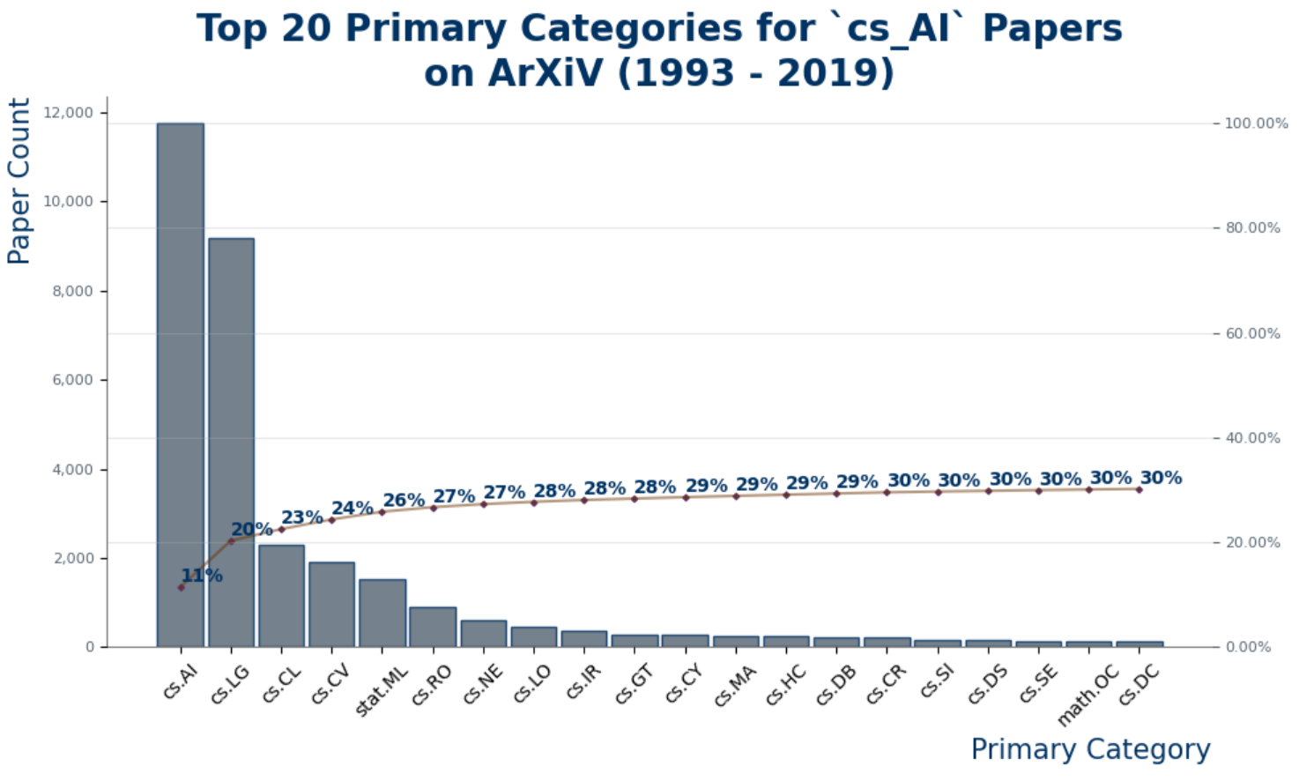
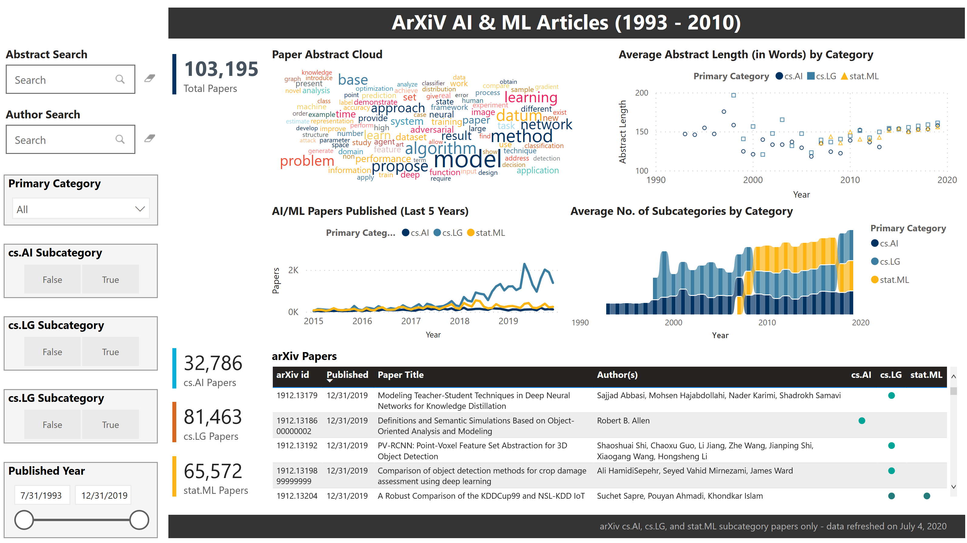
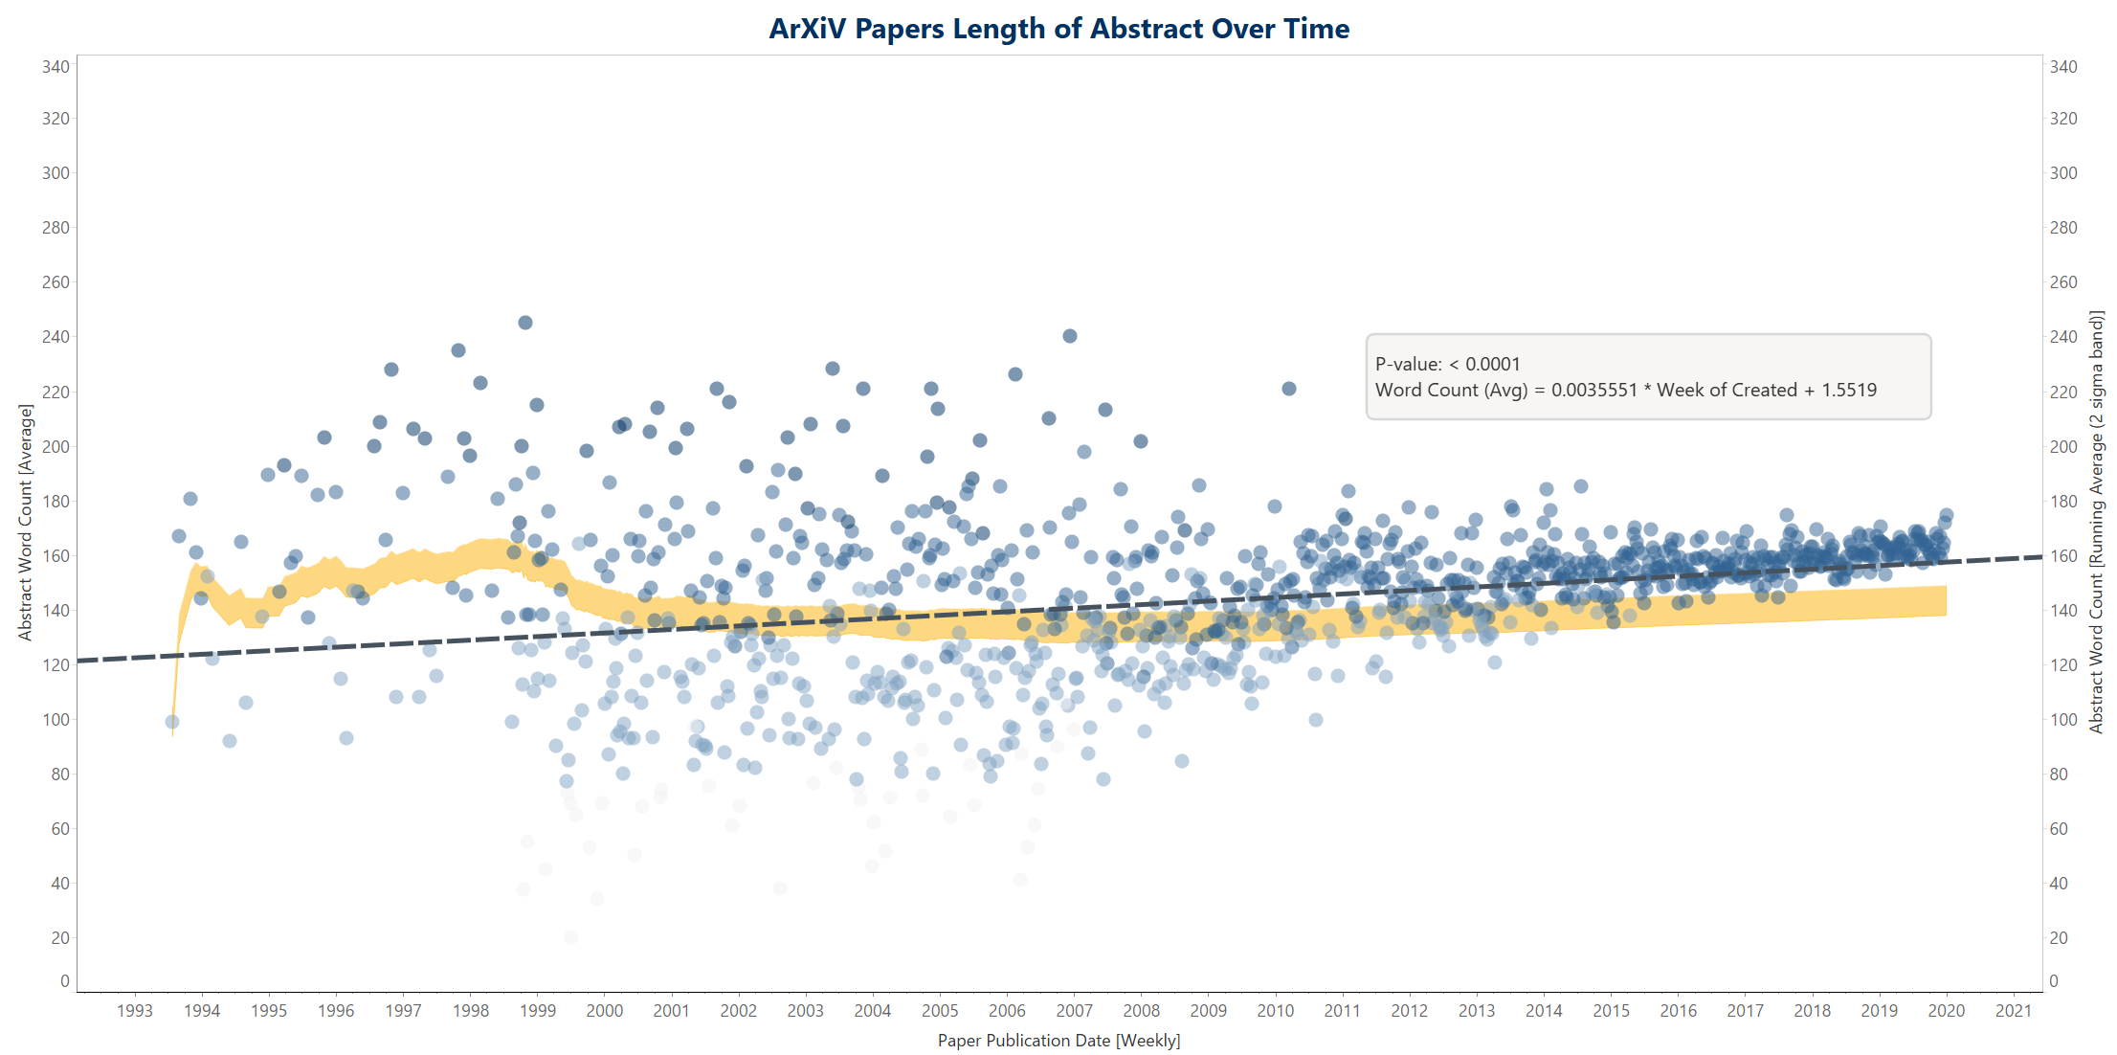
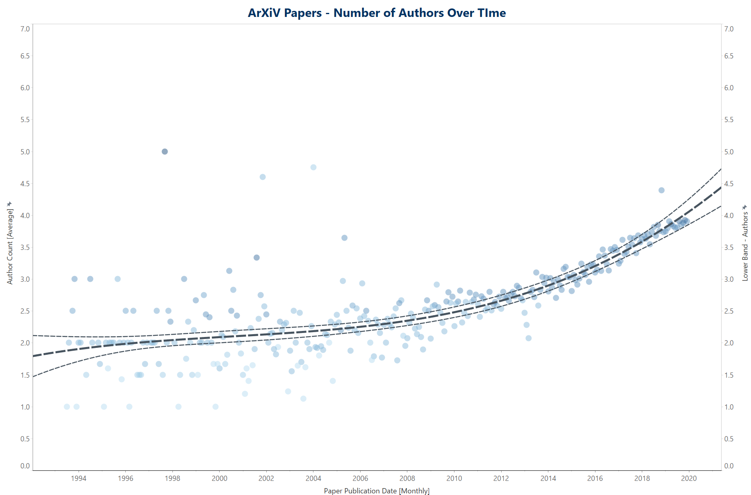
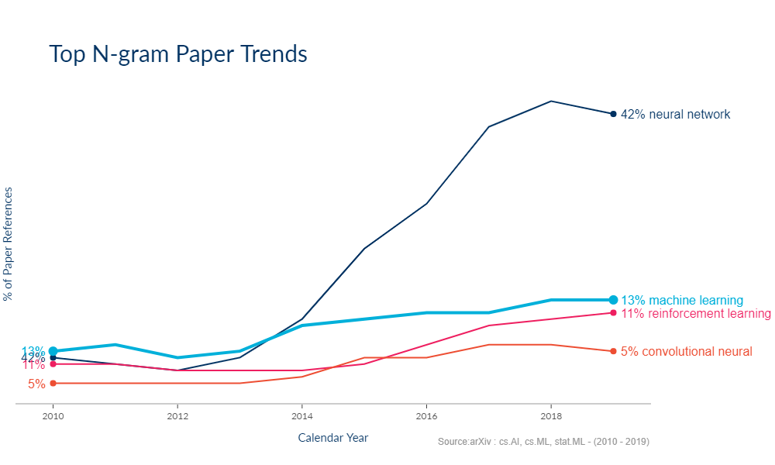
W209
Midterm Presentation
THANKS
QUESTIONS?

